Slide 1
Travel for Fun

Slide 2

TFuN

Slide 3
1. Is it really invention ?

Slide 4
Similar apps
 | Yandex | Yelp | Google
Localization | 80% | 60% | 85%
Most-fit | 40% | 30% | 50%
Reliable | 70% | 60% | 70%

Slide 5
Usefull features of our apps
Data science for filtering (in process)
Very dynamic for updates
Locally convenient
Simple, helpful and pleasing interface
Low hardware requirements

Slide 6
Cross Product
Use from any device you have, with only one google account

Slide 7
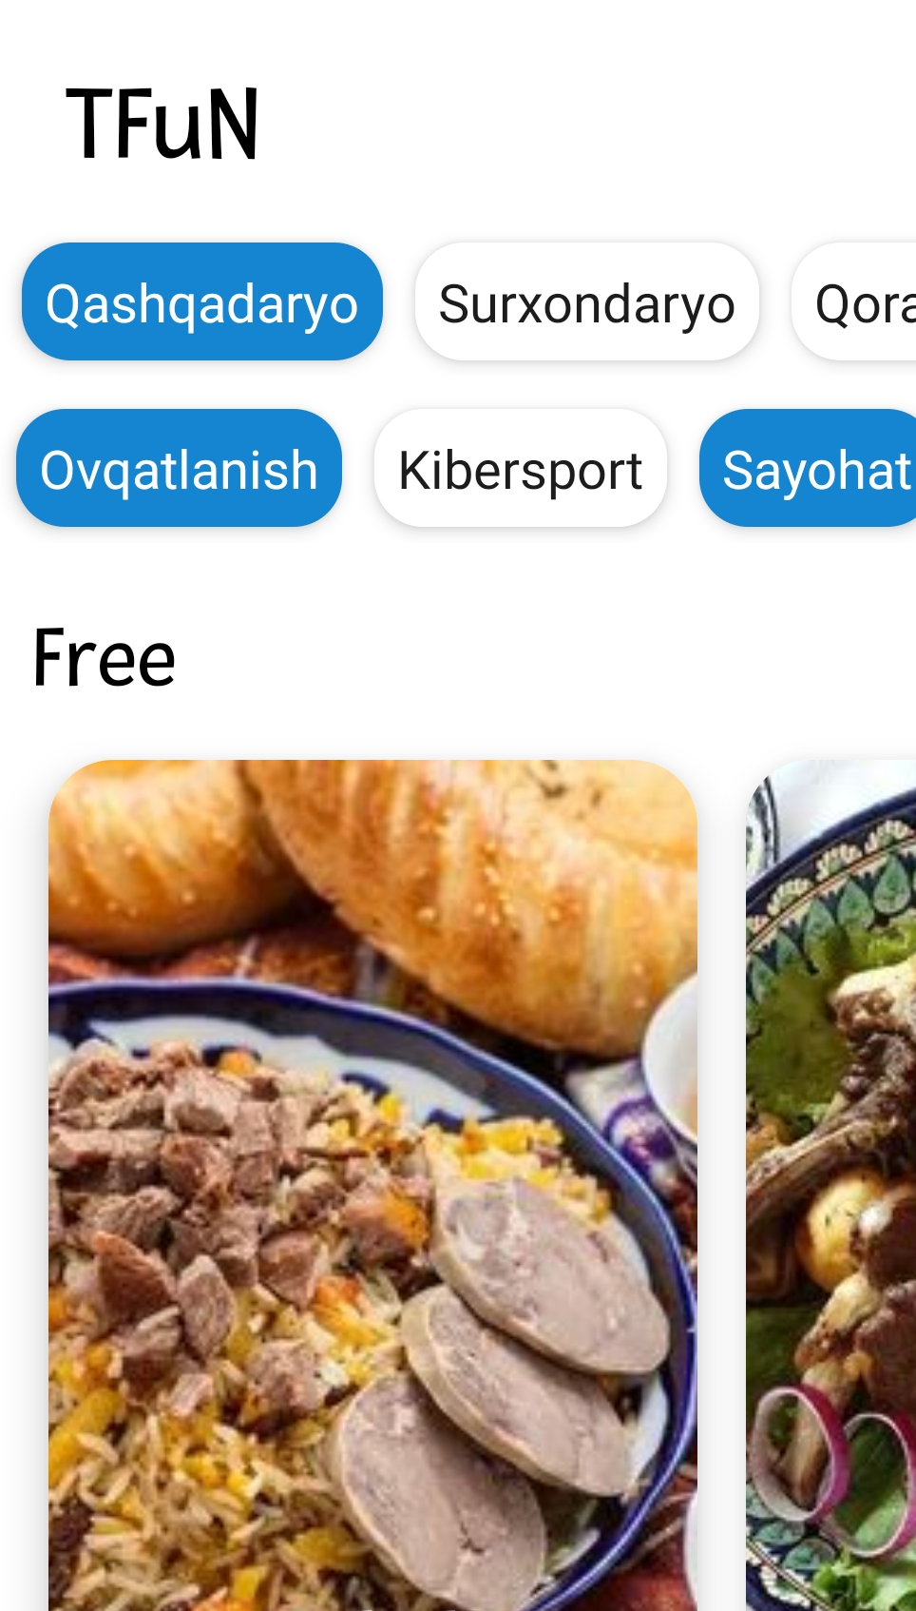
Mobile version
Place your screenshot here

Slide 8
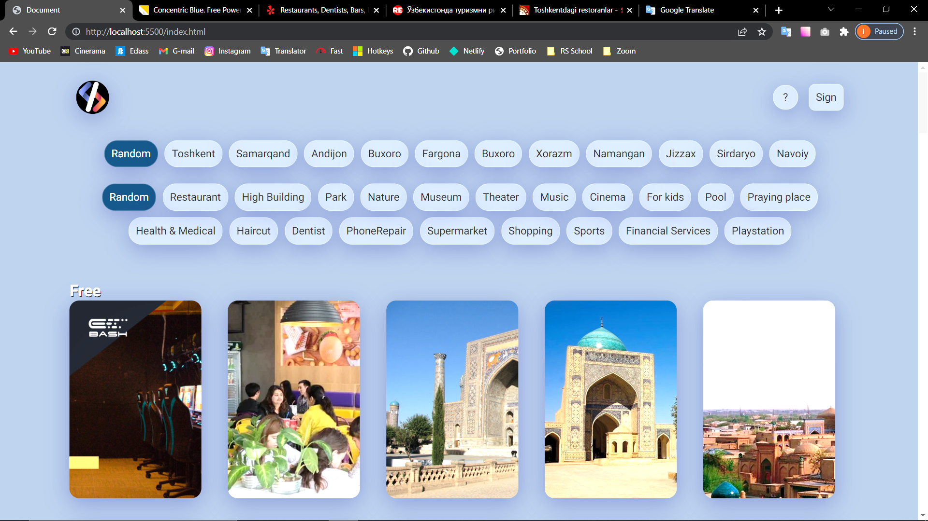
Desktop project
Place your screenshot here

Slide 9
15,644,545

Slide 10
Thanks!
Any questions?

